Slide 1
Real Time Systems
Scheduler

Slide 2

Why should my software use a scheduler?
Due the complexity of moderns systems, just is not enough to make software without tools like schedulers or RTOS. They are useful to manage complexity.
Using scheduler makes easier to do more things with a single resource, and takes lot out of it.
Easy and fast integration of multiple modules developed separately.
Help to resolve timing problems using the fewest timers peripheral.
Easy maintenance.
Etc.
<number> / Enrique Rodríguez Toscano, David Robles Romero / Date © Continental AG

Slide 3
Concepts
Feature. It is a software module, at application level or driver level. The software system is structured by several features. They define the system behavior.
Task. A task is a container for features. It have priority, execution period and duration (running time).
Cooperative scheduling. Cooperative scheduling relies on the cooperation of the programmed tasks to allow a system to function correctly. The tasks decides to free itself the µC resources to allow to another one takes the µC control. The scheduler provides timing to execute the task. Tasks are deterministic. Only ISRs can interrupt the running task.
Task priority. It is a rule to determine which task is the most important to attend of a group of ready to execute tasks.
Periodic task. It is a task that is called regularly by the scheduler since the system starts. Unlike to a periodic interrupt, a periodic task can not be disable. Its main characteristics are duration and execution period.
Execution period. For a periodic task, the execution period is the time between two consecutive calls to the task.
Task duration. It is the time measure from task start to task end. If the task is periodic, this measure is taken within a execution period.
<number> / Enrique Rodríguez Toscano / Date © Continental AG
Notes:
Preemptive scheduling. In preemptive scheduling the tasks are executed according to their priorities. If a higher priority task is request when running a lower priority task, the scheduler interrupts the lower priority task and it gives the µC control to the higher priority task.

Slide 4
Concepts
Scheduler tick. Interrupt generated periodically, whose function is to define the maximum duration of a scheduler cycle. Henceforth, “tick” and “scheduler tick” can be used likewise.
Scheduler cycle. For cooperative scheduling, a scheduler cycle or step is the amount of task which the scheduler have to execute between consecutive ticks. The scheduler cycle duration is invariable, but the scheduler cycle could be different on each cycle, depends on the programmed task for certainly cycle.
Starting tick and ending tick. A tick defines the end of the current scheduler cycle and the start of the next scheduler cycle. Although the same tick defines the start and the end of a scheduler cycle, starting tick and ending tick will be used as different concepts.
Scheduler state IDLE. If the scheduler finished its cycle before the ending tick happens, the scheduler state change to IDLE.
Scheduler overlap. a scheduler overlap condition is when the scheduler finishes its cycle after the ending tick happened. This condition is undesirable.
<number> / Enrique Rodríguez Toscano / Date © Continental AG

Slide 5
Concepts
Interrupt Service Routine (ISR) or ISR handler. It is a special function which is called by the micro when a particular condition (event) from hardware or software is present.
Interrupt vector. Is the place in the code where the program counter points after an interrupt has been generated.
Interrupt vectors table. It is a list of all the interrupt vectors available for a specific microcontroller.
Periodic task rule. For a periodic task, its duration must be lower than its execution period.
Cooperative scheduling rule. The amount of the tasks durations programmed for a specific scheduler cycle must be lower than the scheduler cycle duration.
<number> / Enrique Rodríguez Toscano / Date © Continental AG

Slide 6
Characteristics
This scheduler have cooperative scheduling policy.
All the tasks are periodic tasks.
The scheduler cycle duration is configurable (default 1ms).
All the tasks have the same priority.
The tasks are deterministic.
Interrupt management is independent of the scheduler, however, certain conditions have to accomplish in order scheduler an interrupts work correctly together.
Tasks initializations do not have time limitations; Interrupts are not available in this phase.
<number> / Enrique Rodríguez Toscano / Date © Continental AG

Slide 7

Advantages and drawbacks
Advantages:
  Simple.
  It use few microcontroller resources.
  Easy to share variables between tasks.
  Free source.
  Free ($).
  Easy to migrate to others microcontrollers.
  Tasks are deterministic.
Drawbacks:
  Reaction time.
  Task duration must be limited.
<number> / Enrique Rodríguez Toscano, David Robles Romero / Date © Continental AG

Slide 8
Goals
Become familiar whit scheduling usage.
Know basics of scheduler working.
Add and remove features inside a task.
Add and remove tasks from the scheduler.
Execute features with different periods than the task contained them.
Use interrupts together with scheduler.
State machine programming.
<number> / Enrique Rodríguez Toscano, David Robles Romero / Date © Continental AG

Slide 9
Procedure
Exploring the project.
Compiling.
Load the software.
Running the application. LED1 is flashing.
Add features. Make flashing LED2 and LED3.
Remove features. Make LED1 are not flashing anymore.
<number> / Enrique Rodríguez Toscano, David Robles Romero / Date © Continental AG

Slide 10
Task duration vs task execution period
Task duration and task execution period are different concepts.
Example: We have programmed three tasks.
The next figure show how the tasks are executed by the microcontroller.
Task name | Period | Duration
Task_5ms | 5 ms | 400 us
Task_10ms | 10 ms | 200 us
Task_20ms | 20 ms | 300 us
<number> / Enrique Rodríguez Toscano, David Robles Romero / Date © Continental AG

Slide 11
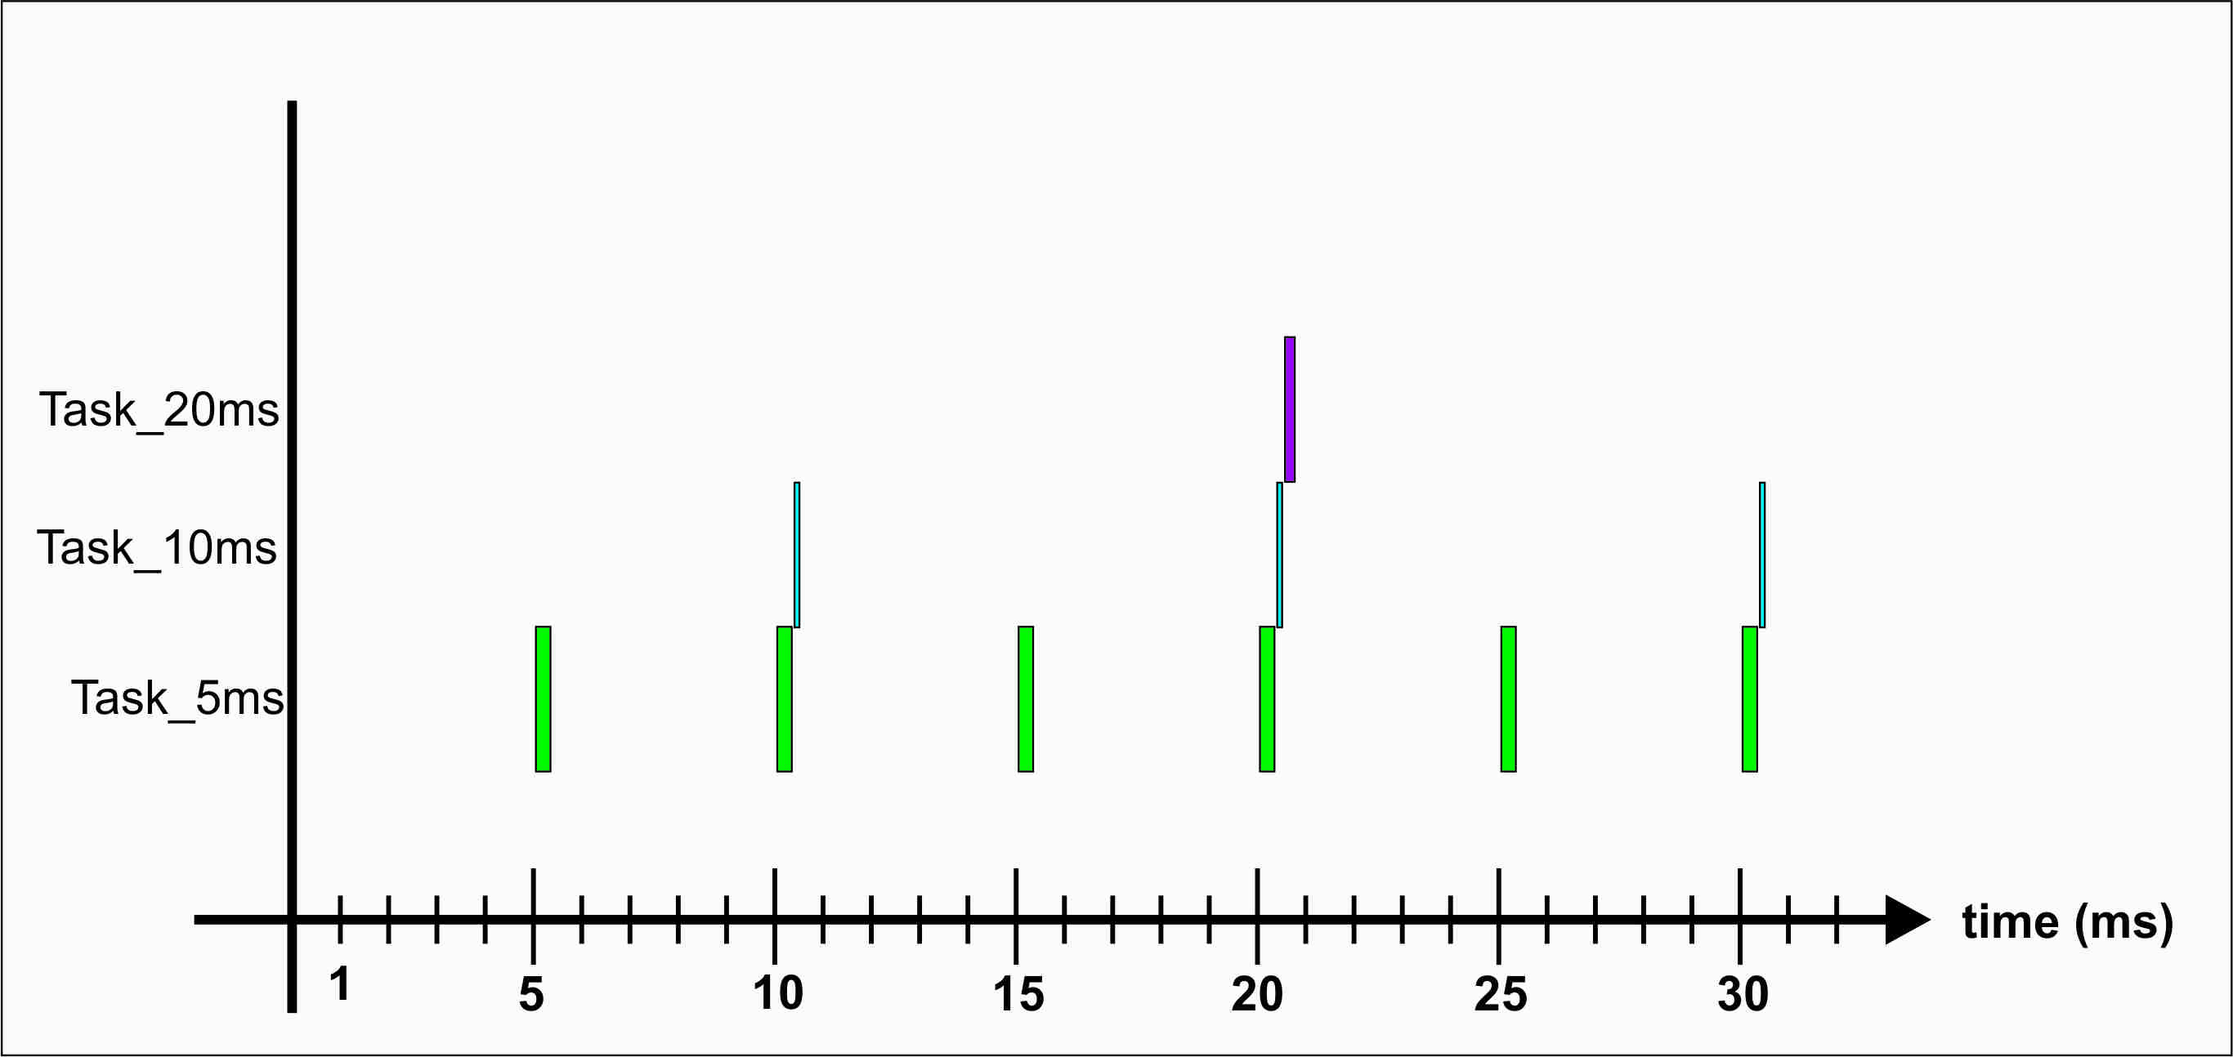
Task duration vs task execution period
Tasks are executing at different periods
<number> / Enrique Rodríguez Toscano, David Robles Romero / Date © Continental AG

Slide 12
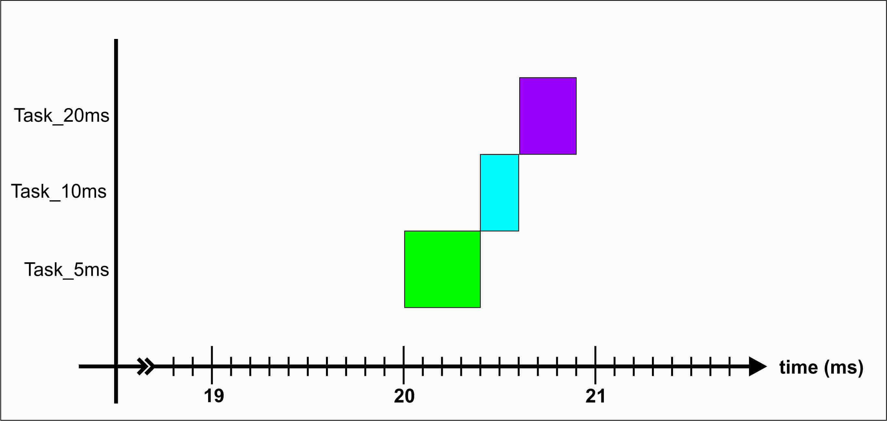
Task duration vs task execution period
Tasks have different duration time
<number> / Enrique Rodríguez Toscano, David Robles Romero / Date © Continental AG

Slide 13
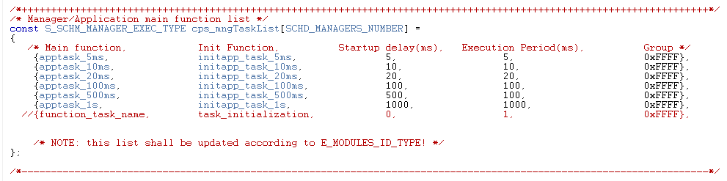

Tasks
The tasks are programmed in the scheduler table.
Column headers.
Main function. Contain the name of the tasks that are executed by the scheduler.
Init function. Contain the name of the functions that initialize the tasks.
Startup delay. It is the time that the tasks have to wait before they will be executed by first time.
Execution period. It is the execution period of the tasks.
Group. It is useful to define system operational modes.
<number> / Enrique Rodríguez Toscano, David Robles Romero / Date © Continental AG

Slide 14
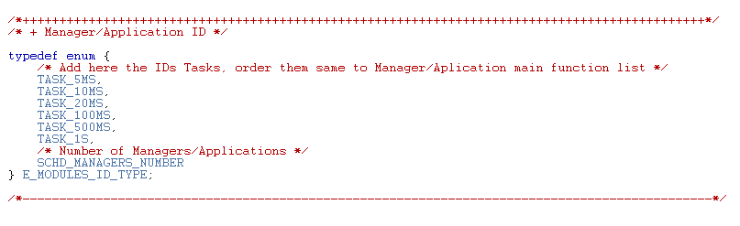
Tasks
Also it is need to count the tasks.
The value SCHD_MANAGERS_NUMBER is the number of tasks the scheduler will be executing.
<number> / Enrique Rodríguez Toscano, David Robles Romero / Date © Continental AG

Slide 15
Procedure
Remove the task of 500ms. LED3 are not flashing anymore.
Add a new task with execution period of 700ms. Make flashing LED4.
Execute features with different periods than the task contained them.
Check the next code:
/* Start counter at 1 to prevent modulus operand to enter the first time */
static T_UBYTE lub_20ms_counter = 1;
/* Run every 40 ms (20ms task x 2) */
if((lub_20ms_counter % 2)== 0)
{
/* Add here the task to execute every 40 ms */
task();
}
/* Run every 320 ms (20ms task x 16) */
if((lub_20ms_counter % 16)== 0)
{
/* Add here the task to execute every 320ms */
task();
/* Clear counter but will be set to 1 in next instruction */
lub_20ms_counter = 0;
}
lub_20ms_counter++;
<number> / Enrique Rodríguez Toscano, David Robles Romero / Date © Continental AG

Slide 16
Procedure
After the last step the four LEDs are flashing.
Use interrupts together with scheduler.
Initialize interrupt to use.
// Init and enable PIT module (All channels)
PIT_initModule();
// Configure PIT channel cero to create an interrupt every 250 ms
PIT_init(0,16000000UL);
// Start timer
PIT_EnablePITchannel(0, TRUE);
<number> / Enrique Rodríguez Toscano, David Robles Romero / Date © Continental AG

Slide 17
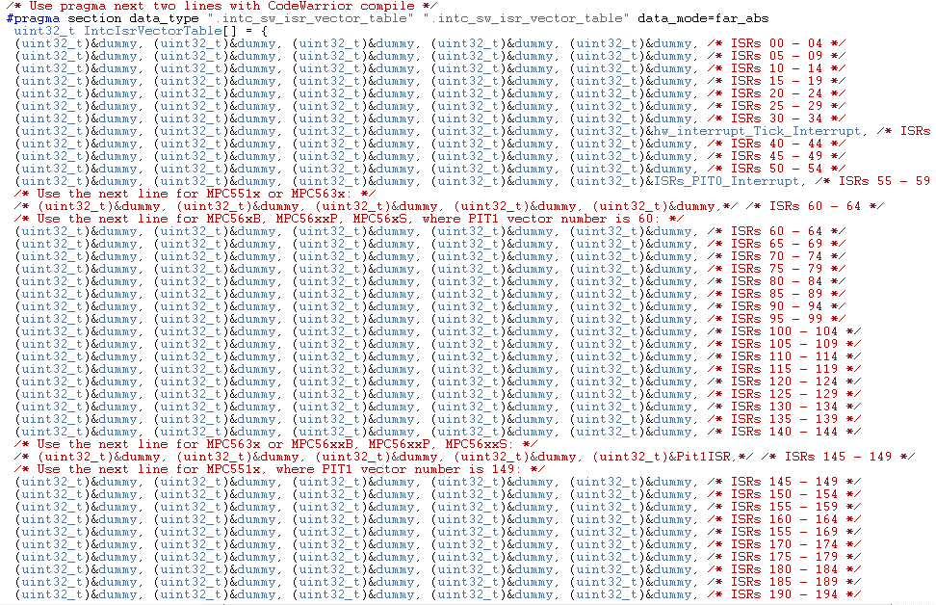
Procedure
Interrupt Vector Table:
<number> / Enrique Rodríguez Toscano, David Robles Romero / Date © Continental AG

Slide 18
Procedure
Machine state programming.
<number> / Enrique Rodríguez Toscano, David Robles Romero / Date © Continental AG

